Slide 1
CSE302: Computer Networks Project
Hosting a web application using
port forwarding technique
Presented By
Kondur Ranjith Kumar(124003147)
Date of Presentation: 14.12.2022
1

Slide 2
AIM & OBJECTIVES
Implementation of the Port Forwarding which is an application of Network address translation in Internet protocol of Network layer with help of hosting a web application.
Objective 1: Understanding IP & Port Forwarding & TCP,.
Objective 2: Implementing port forwarding using ngrok software
Objective 3: Benefits to users :
        They can build their own sites
        To access services that are normally unavailable due to the firewall settings.

Slide 3

Problem Statement & Solution
Problem Statement :
Gaining access to a public website without disclosing the IP Address of the Sender computer(Server) , and being able to transmit data to the recipient while only knowing the IP Address of the sender(Client) to Server and to secure the page by blocking the unwanted traffic.
In simple words, how to run a publicly-accessible website from your home computer and to protect data and web application with unwanted access.
The Solution :
In today's world, having a secure webpage is invaluable. With port forwarding, users can make their webpages secure by blocking any unwanted traffic. This allows a user to control who can access their website, data, or services. Furthermore, port forwarding also helps to strengthen the security of the page by hiding the ports that the page is using. Securing a webpage to make it safe from hackers and other malicious attackers is an important feature for many businesses. Port forwarding is an effective security measure that can be used to protect webpages and the data contained there in. When port forwarding is enabled, all incoming traffic to a given port is redirected to the protected network or host.

Slide 4
System configuration
Server
  Software used : XAMPP &NGROK
  Network: wireless
  Protocol : IP protocol
  Hardware used: Raspberry pi board(Optional)
Client
  Application Software : A Browser
  Network : wireless
  Protocol: IP protocol

Slide 5

What is XAMPP & NGROK ?
XAMPP :
XAMPP is a cross-platform web server that is free and open-source. XAMPP is a short form for Cross-Platform, Apache, MySQL, PHP, and Perl. XAMPP is a popular cross-platform web server that allows programmers to write and test their code on a local webserver.
Advantages :
It is simple to set up when compare to other web servers such as LAMP.
With a single command, you may start and stop the entire web server and database stack.
NGROK :
Ngrok is an open source program that allows us to securely port forward our localhost machine to the web. It allows us to easily test our web applications and APIs on different devices and networks without having to manually configure our routers. By tunneling through ngrok, we are able to bypass common barriers associated with testing localhost on different platforms. The program also provides us with a public URL, allowing us to share our applications with anyone, regardless of their location.

Slide 6
Network Architecture
Port forwarding is an excellent way to preserve public IP addresses. It can protect servers and clients from unwanted access, “hide” the services and servers available on a network and limit access to and from a network. Port forwarding is transparent to the end-user and adds an extra layer of security to networks. In short, port forwarding is used to keep unwanted traffic off networks. It allows network administrators to use one IP address for all external communications on the Internet while dedicating multiple servers with different IPs and ports to the task internally.

Slide 7
Working Flowchart
Launch XAMPP Panel
Start Apache and MySQL in XAMPP
Allocation of Ports by XAMPP
Open Terminal of NGROK and establish connection with the allocated port by XAMPP
Forwarding Link will be generated by NGROK
Output can be tested using forwarding link in different systems.

Slide 8
      Advantages of Hosting your own Website
If you host your own site, you can have complete control over your site. This means you have the ability to manage the amount of space you have and how much you need to provide the best website possible for your customers.
Quick response times.
Infinite Customization Possibilities.
Its Relatively easy.

Slide 9
Proposed Protocol Description
IP :
Internet Protocol (IP) addresses are a series of numbers and decimals assigned to a device that is connected to the internet. This address allows the data packets to be routed to the correct destination. Port forwarding is a way of forwarding network requests to a specific port on an IP address to a different port on the same IP address, allowing for a more secure connection. Port forwarding enables the user to open up ports to external access, which allows them to receive data from other applications or devices.
HTTP:
Flexible - The HTTP protocol allows the sending of any kind of data. One request will be accepted per connection as it is a connectionless protocol.
HTTP clients generally use Transmission Control Protocol (TCP) connections to communicate with servers.
TCP:
Used for communication between two endpoints, commonly referred to as clients and servers. Using the source and destination IP addresses, and the port numbers, TCP is able to establish a connection between them. It then uses this connection to communicate and exchange data.
Here ,we use ports 80/443 which are used by HTTP/HTTPS. The connection-oriented protocol TCP demands handshaking to set up end-to-end communications.

Slide 10
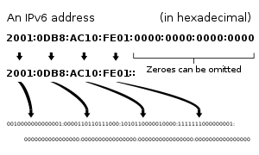
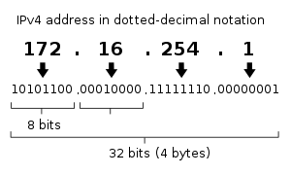
Internet Protocol (IP) is a network addressing system used by computers to communicate with each other. Each computer has its own unique IP address, which is used to identify and locate it on the Internet. There are two versions of IP: IPv4 and IPv6. IPv4 uses 32-bit addresses, while IPv6 uses 128-bit addresses, which allow for a much larger range of possible address combinations.
INTERNET PROTOCOL address is a numerical Label assigned to each device connected to a network.
Which also uses the internet protocol for the communication.
IP address serves as two main functions :-
Host or Network Interface Identification
Location addressing

Slide 11

Network Address Translation(NAT)
NAT translation table
WAN side addr LAN side addr
1: host 10.0.0.1 sends datagram to 128.119.40.186, 80
2: NAT router changes datagram source address from 10.0.0.1, 3345 to 138.76.29.7, 5001,
updates table
138.76.29.7, 5001 10.0.0.1, 3345
…… ……
S: 10.0.0.1, 3345
D: 128.119.40.186, 80
10.0.0.1
1
2
S: 138.76.29.7, 5001
D: 128.119.40.186, 80
10.0.0.4
10.0.0.2
138.76.29.7
S: 128.119.40.186, 80
D: 10.0.0.1, 3345
4
S: 128.119.40.186, 80
D: 138.76.29.7, 5001
3
10.0.0.3
3: reply arrives, destination address: 138.76.29.7, 5001

Slide 12
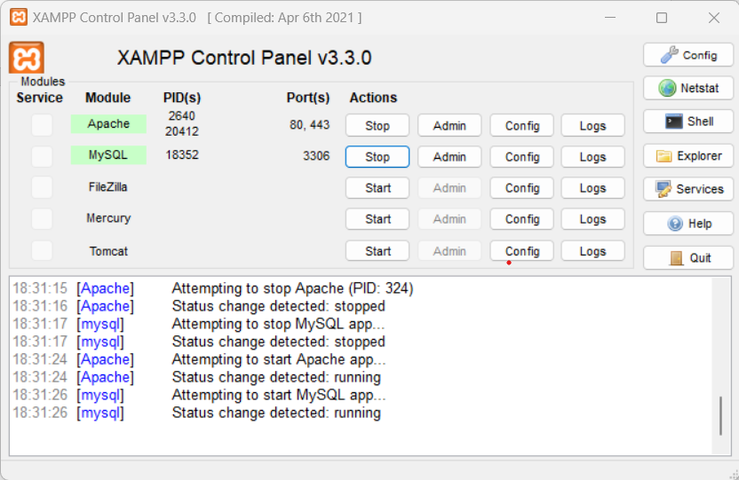
Sample I/O screen shots
Start action of Apache, MySQL on XAMPP Control Panel

Slide 13
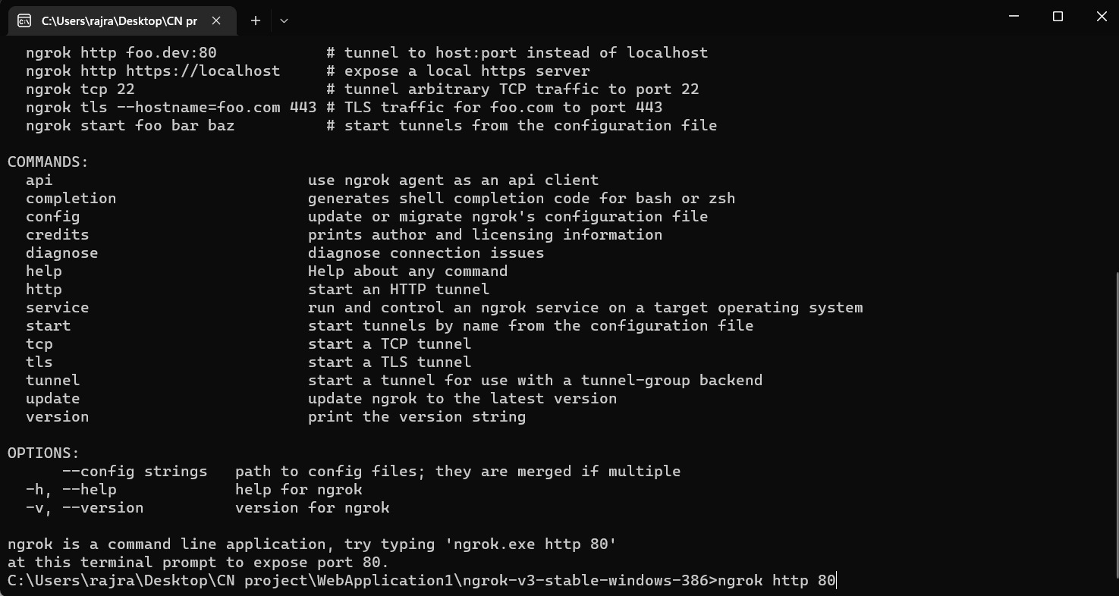
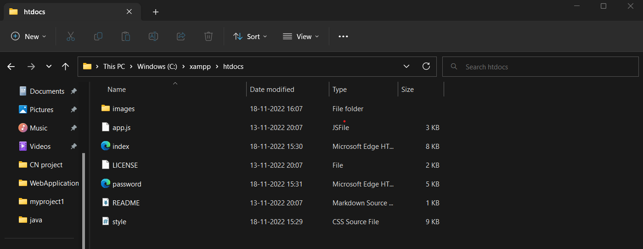
Command Prompt of NGROK
Storing All the codes in htdocs of xampp

Slide 14
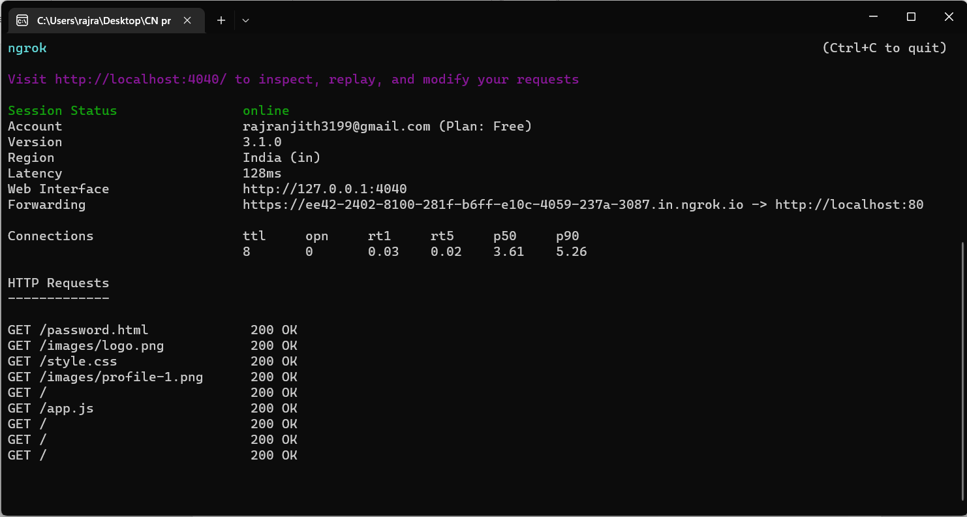
Activating the NGROK part to make the website accessible in LAN

Slide 15
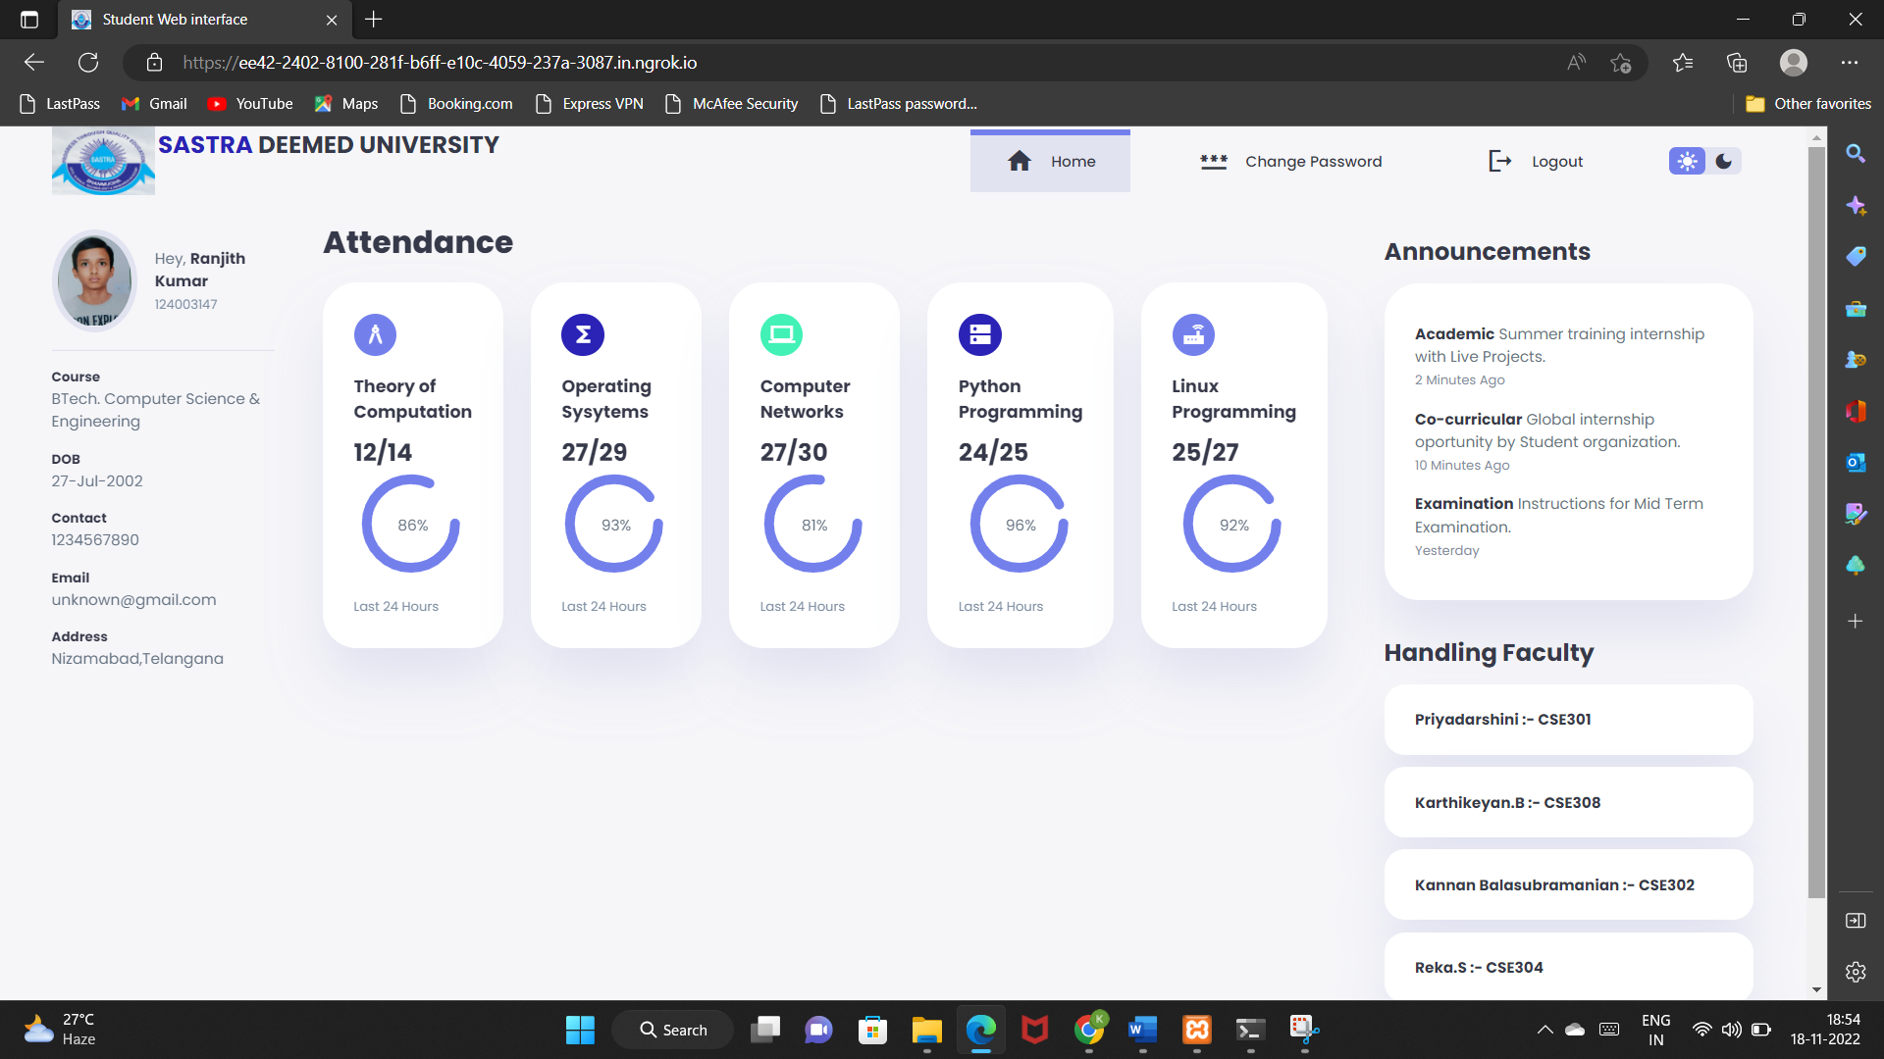
Executed Output using forwarding link generated by NGROK

Slide 16
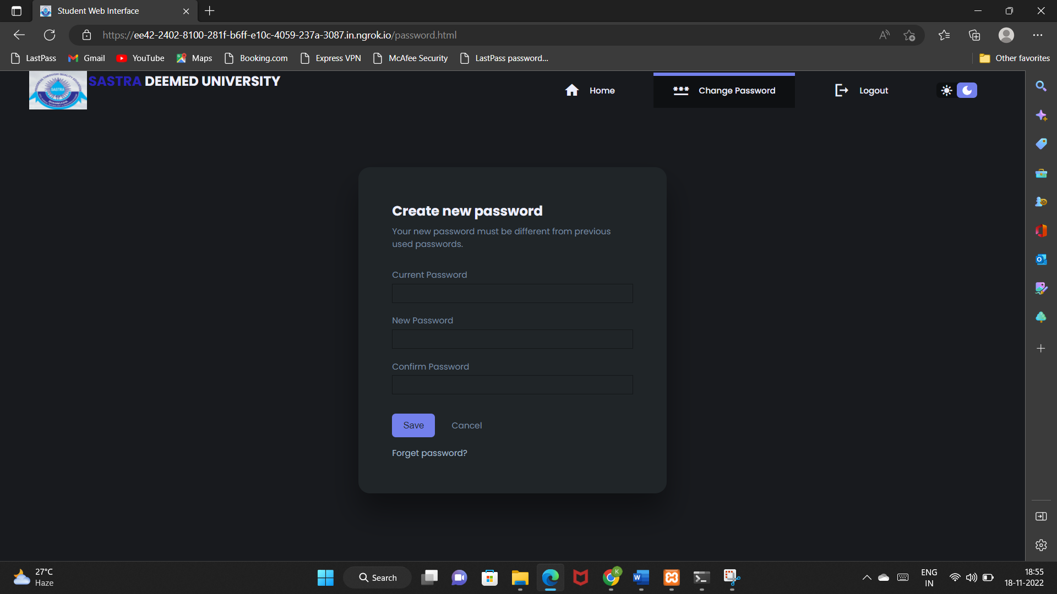

Slide 17
CONCLUSION AND FUTURE WORKS
A comprehensive study and a practical knowledge are very important in this particular project and in the real world. The most commonly platform used by developers that furnishes a suitable environment to test and verify working of their projects based on Apache, MySQL etc through the system of host itself. HTML is used to design the webpage and to insert programs. As it is connected to the LAN, it takes some time to connect to the server as it is connected. Once it is completed, the project has been done using the help of the Port forwarding technique and NGROK. This protocol gives the effective simulation results of this part of the work in the term of packet delivery ratio, loss packet ratio and router reliability. I will carry out more and more webpages like this to the entire world. This scheme is more effective output in terms of execution and also considered parameters.

Slide 18
References
15
"Definition of: port forwarding". PC Magazine. Retrieved 2008-10-11.
Rory Krause. "Using ssh Port Forwarding to Print at Remote Locations". Linux Journal. Retrieved 2008-10-11.
Jeff "Crash" Goldin. "How to set up a home web server". Red Hat. Archived from the original on 2008-10-04. Retrieved 2008-10-11.
OpenSSH Port forwarding
"Local and Remote Port Forwarding and the Reflection for Secure IT Client 7.1 or Higher - Tech Note 2433". Support.attachmate.com. 2012-11-09. Retrieved 2014-0130.
Alex Chaffee (2000-08-17). "What is a web application (or "webapp")?". Retrieved 2008-07-27.

Slide 19

17

